Slide 1
Baking in the Last Touches
Project Phase Four Overview

Slide 2
Phase Four Overview
FRONT END: The client-side development of MealMind is now fully complete, with all user interfaces functional and polished. Screenshots of the main interfaces have been organized in a dedicated screenshots folder within the GitHub repository, each accompanied by descriptive notes. Front-end codebase has been cleaned to remove any intermediate or unnecessary files, ensuring an organized and maintainable project structure.
BACK END: The server-side development is also fully finished and capable of handling all client requests effectively. The back end supports critical functions such as processing recipe filters, managing user authentication, and storing data.The back-end source code is maintained carefully in the GitHub repository, with obsolete or temporary files removed for clarity and ease of maintenance.

Slide 3
Phase Four - Project Management
PROJECT MANAGEMENT: - Source code has been carefully maintained and version-controlled on GitHub - All change requests have been tracked in a change log document to manage scope and deliverables efficiently -Key lessons learned during development have been documented to highlight both successes and challenges, offering valuable insights for future projects.
-Maintained communication with the development team, reviewing system architecture and feature changes and ensuring documentation stayed up to date.

Slide 4
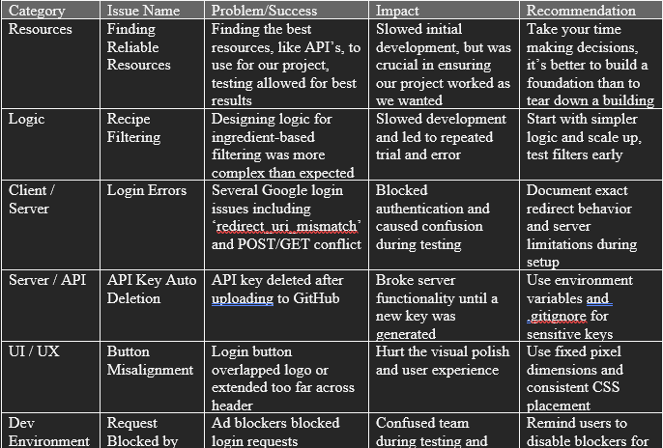
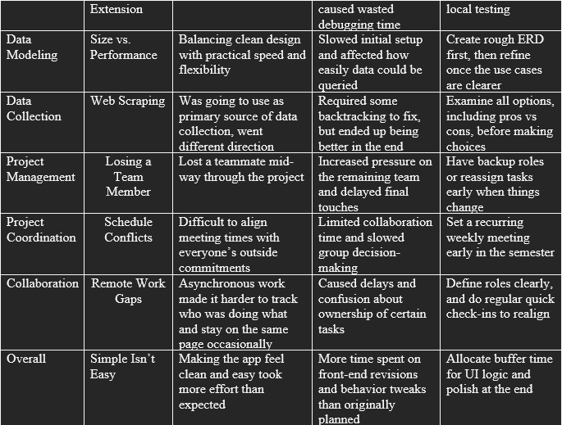
Challenges & Lessons Learned

Slide 5
Unique Challenge - Losing a Team Member
- A large challenged faced, was losing a team member this semester
- Good reflection of real life scenarios
- Split workload and moved forward as best we could

Slide 6
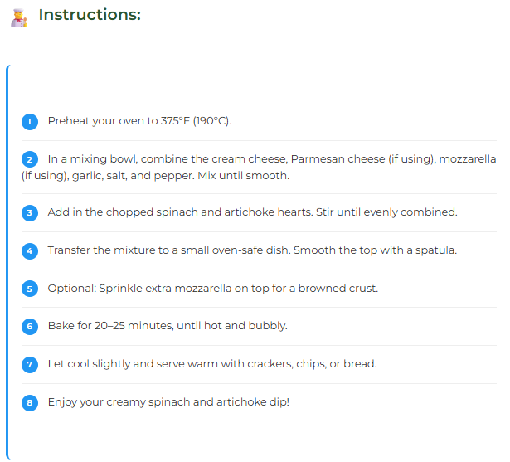
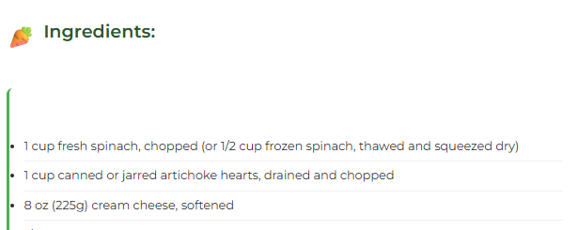
Front End Development
Enhanced overall UI design for a cleaner, more modern look
Updated grocery list layout and styling
Maintained original functionality while refining user experience

Slide 7

Backend Development
Implemented delete functionality for grocery list items
Improved request handling between frontend and backend
Ensured smooth data updates without reloading the page

Slide 8
The API Process
Constant revolving door for api keys on the open ai front.
Upfront costs to get the ai running
Google auth required some thought
Session secret

Slide 9
The Database
Everything runs of sqlite
The file runs SQL commands
It’s all stored in a sqlite file which is encrypted
Cannot be read fully in just the text editor

Slide 10
Live Demonstration

